Slide 1

Addressing the National Childcare Affordability Crisis
By Miles A. Peña

Slide 2

Agenda
Introduction and Context: Overview of the childcare affordability crisis.
Data Overview: National childcare price trends (2008-2018).
State-Level Disparities: Top 5 most and least expensive states for childcare.
Impact on Families: How rising costs impact economic mobility and working families.
Policy Solutions: Proposals for subsidies, tax incentives, and federal funding.
Call to Action: Immediate legislative priorities to address the childcare crisis.

Slide 3

The Urgent Need for Affordable Childcare Solutions
Rising Childcare Costs: Childcare costs are increasing rapidly, outpacing household incomes.
Economic and Family Impact: Rising costs hurt economic mobility and family well-being.
State-Level Disparities: Childcare costs vary widely across states, with some regions facing extreme burdens.
Need for Action: Policymakers need to act now to ensure affordable, accessible childcare for all.

Slide 4

Childcare Price Trends and Economic Disparities (2008-2018)
Childcare Costs vs. Household Income: Childcare costs rose by 22.48% (Center Based Care) & 20.56% (Family Childcare) compared to 18.67% for median household incomes.
State-Level Disparities: Significant variation in childcare costs on average between states, e.g., $1,423 in Massachusetts vs. $400 in Mississippi.
Impact on Low-Income Families: Low-income families spend a much higher percentage of their income on childcare.

Slide 5
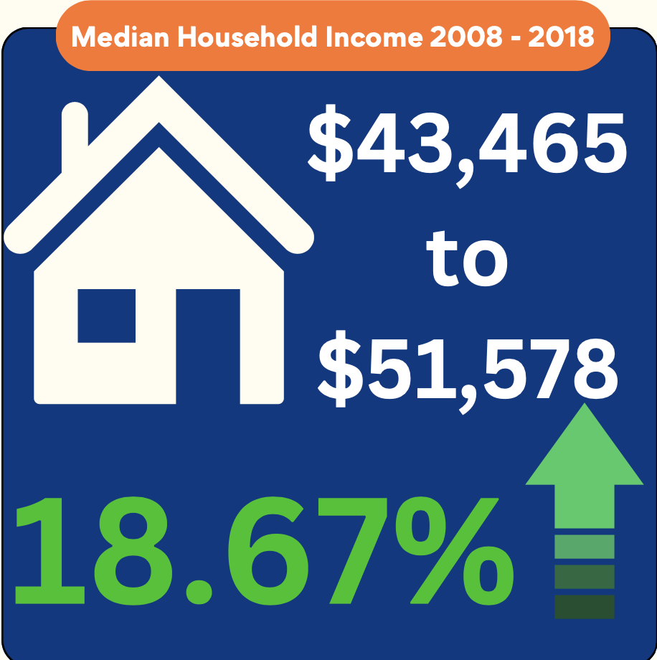
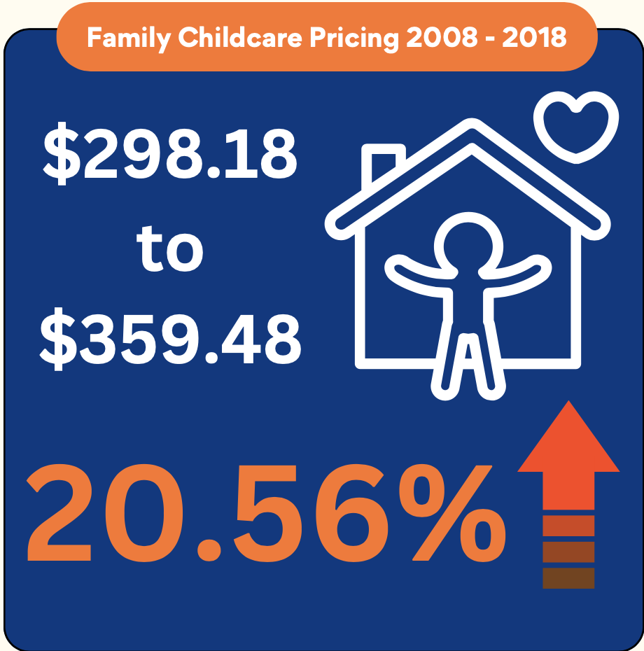
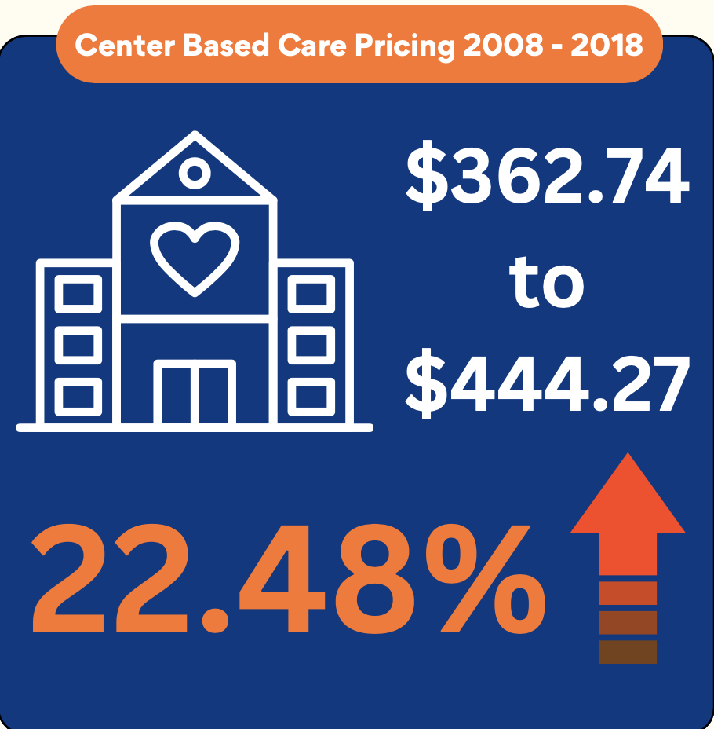
Childcare Costs vs. Household Income
This widening gap is making quality childcare increasingly unaffordable, especially for working families.

Slide 6
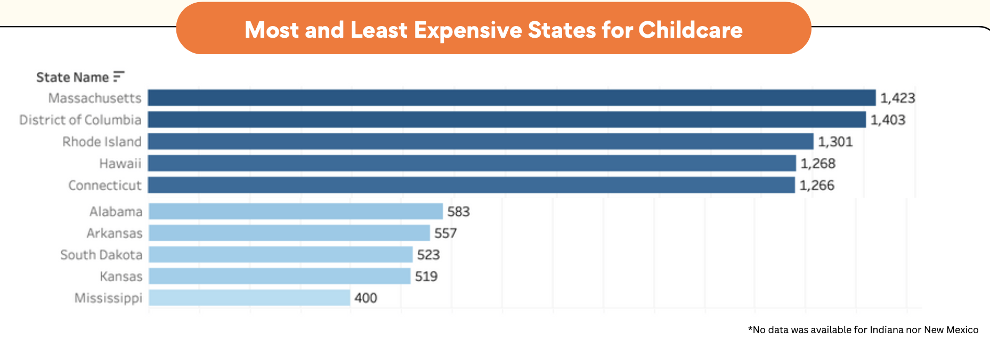
State-Level Disparities
This affordability crisis is not distributed evenly across the country. In some states, families are paying significantly more for childcare compared to others.

Slide 7
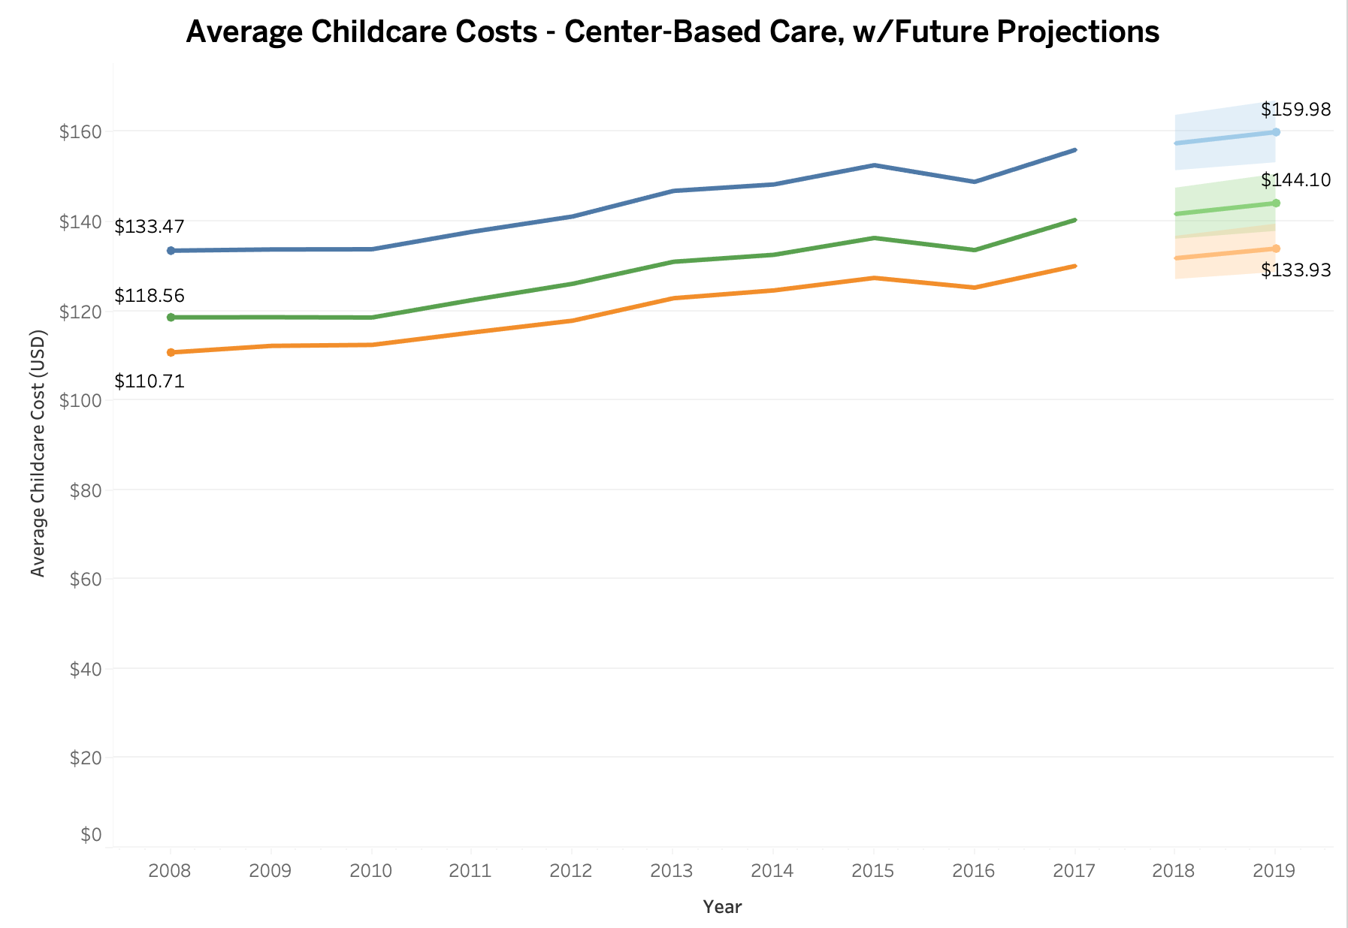
Rising Costs of Center-Based Childcare
Rising childcare costs are projected to continue, indicating potential need for subsidies or policy intervention.
Families with higher-cost care (e.g., younger children or certain care settings) may face greater financial burdens.

Slide 8
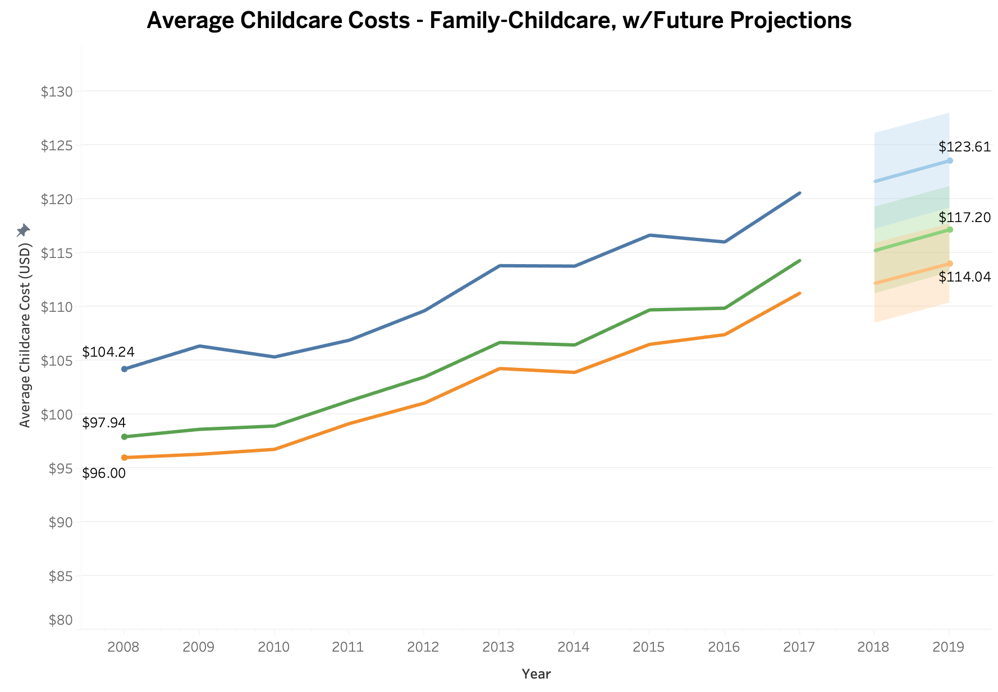
Rising Costs of Family Childcare
Family-based care, though typically less expensive than center-based care, is still seeing significant cost increases.
Projections indicate that future costs will continue to rise, further straining family budgets, particularly for low- and middle-income households.

Slide 9

Impact of Rising Childcare Costs on Low-Income Families
Disproportionate Burden: Low-income families spend over 30% of their income on childcare.
Limited Access to Quality Care: Higher costs push families toward lower-quality childcare.
Reduced Workforce Participation: High childcare costs reduce employment opportunities, particularly for women.
Widening Inequality: Rising costs contribute to growing economic inequality.
Recommendation: Subsidies and financial support are critical for equal access to affordable childcare.

Slide 10

Policy Solutions to Address the Childcare Affordability Crisis
Expand Subsidies: Increase federal subsidies so no family spends more than 7% of their income on childcare.
Tax Incentives for Providers: Offer tax breaks to providers who lower costs or serve underserved areas.
Increase Federal Funding: Boost federal investment in childcare infrastructure to improve quality and reduce costs.
Sliding Scale Payments: Ensure families pay only what they can afford, based on income.
Support Universal Pre-K: Expand universal pre-K to provide affordable early education for all children.

Slide 11

Ensuring Affordable Childcare for All Families
Recognize the Urgency: Childcare costs are rising unsustainably; action is needed now.
Prioritize Low-Income Families: Focus on laws that provide subsidies and reduce the burden on struggling families.
Commit to Federal Funding: Expand federal investment to improve childcare infrastructure and affordability.
Collaborate with Stakeholders: Work across governments and communities to create sustainable, effective solutions.
Take Immediate Action: Implement the proposed policies and ensure affordable childcare for all.

Slide 12

References
National Database of Childcare Prices. (n.d.). US Department of Labor. https://www.dol.gov/agencies/wb/topics/featured-childcare
National Database of Childcare Prices. National database of childcare prices [Excel file]. U.S. Department of Labor. https://www.dol.gov/agencies/wb/topics/featured-childcare

